Slide 1
Lecture 8 – User Authentication
Chad Mourning
Heavily from Textbook

Slide 2
Basic Security Requirements
From NIST SP 800-171 – c. 2016
Identify information system: users, processes acting on behalf of users, or devices.
Authenticate (or verify) the identities of those users, processes, or devices, as a prerequisite to allowing access to organizational information systems.

Slide 3
Derived Security Requirements
Use multifactor authentication for local and network access to privileged accounts and for network access to non-privileged accounts.
Employ replay-resistant authentication mechanisms for network access to privileged and non-privileged accounts.
Replay Attack Example Here
Prevent reuse of identifiers for a defined period.
Disable identifiers after a defined period of inactivity.
Enforce a minimum password complexity and change of characters when new passwords are created.
Prohibit password reuse for a specified number of generations.
Allow temporary password use for system logons with an immediate change to a permanent password.
Store and transmit only cryptographically-protected passwords.
Obscure feedback of authentication information.
Username / Password Combo Example

Slide 4
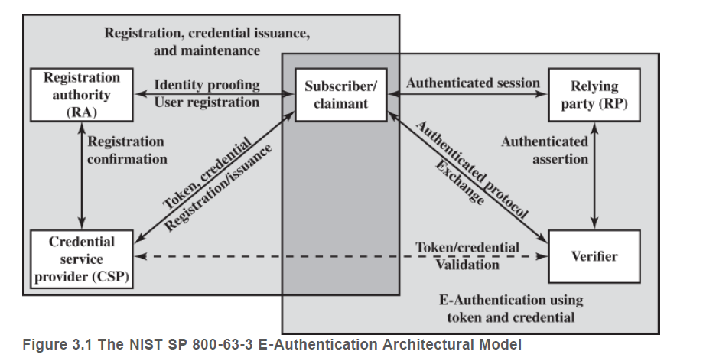
NIST Digital User Authentication Model
June 2017

Slide 5
Means of Authentication
Something the individual knows
Password
PIN
Security Question
Not public information
If you are registered to vote in Athens County, I could look up your address right now.
Same for Property Taxes
All Property Transfers are also published in the newspaper
I google myself from time to time to keep track of media placements
Something the individual possesses: CAC card, key, etc.
Rotating authenticator probably fits here.
Something the individual is (biometrics): fingerprint, retina, facial recognition
I get CLEAR for free through one of my credit cards
Something the individual does: voice, handwriting, gait, typing patterns
Machine Learning makes this a lot more viable

Slide 6
Risk Assessment
We will probably take a deep dive into risk assessment later in the semester.
NIST SP 800-63-3 uses a 4 tier system
Level 1 – Little or no confidence.
Example: Ad hoc username password combo.
Level 2 – “Normal” level of confidence.
Example: Uses some secure protocol like SSL
Level 3 – Higher confidence
Example: Uses 2FA
Level 4 – Highest confidence
Example: Require in person registration, 2FA, biometric, etc.

Slide 7
Potential Impact
FIPS 199 – Same definitions are before
Low
Medium
High

Slide 8
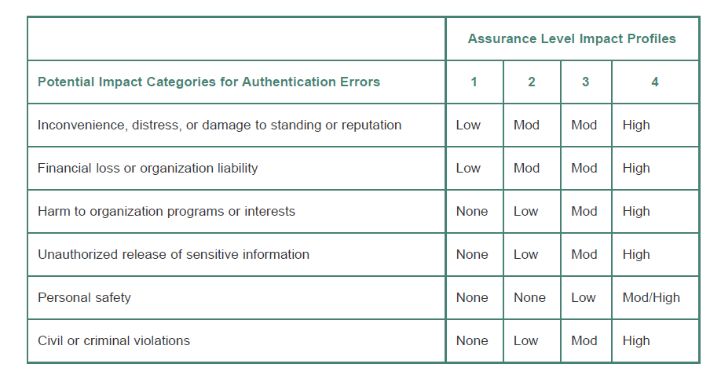
Example Risk Assessment Exercise

Slide 9
Password Attacks and Countermeasures
Popular Password Attack – Don’t use “P@$$w0rd” as your password.
Best defended by forcing a change in password after multiple attempts.
Offline Dictionary Attack – Even hashed passwords have to be stored somewhere.
Used to be called a SAM file in Windows XP
Ophcrack – Windows XP and Vista
Rainbow tables
Maybe more details on how these work later?
Salting
DaveGrohl – MacOS
User-specific attacks: Use specific information about the person.
Loved ones’ names and birthdays for instance.
Countermeasure: Tell them not to do that.
Keyloggers

Slide 10
Password Attacks and Countermeasures, 2
Specific account attack
A brute force attack against a specific known identifier
Typical countermeasure is locking an account after a fixed number of attempts
That reminds me I need to call STRS to reset my password. There’s no self-service.
Workstation Hijacking
This was frequent in the lab when I was an undergrad. Mostly changing people’s wallpaper to something inappropriate if they went to the bathroom without turning on the lockscreen.
Default passwords
Change them.
Alpine

Slide 11
Password Attacks and Countermeasures, 3
Social Engineering
Don’t write down passwords. If the cognitive load is too much, at least obfuscate it.
Don’t tell other people your password, and don’t let them reset it for you unless you are in person.
Verizon cloud hacks.
Repeated Password Use
If it’s hacked somewhere, it’s hacked everywhere.

Slide 12
So why do we still use them?
Biometrics are tricky, and the interface between the hardware and software layers.
Still new and people are researching ways to break them
That may be easier than brute forcing passwords!
Aside: Digital-analog loophole
Physical tokens are inconvenient if lost or forgotten
And they also create a single point of failure across multiple services, unlike using different passwords
Password Managers aren’t quite there yet, so we can’t automate randomized password replacements
Not as much of an issue on a single device, but then you need to check a service on your phone when you are at an airport.
Inertia
I like analogies, Feynman hated them.

